Slide 1
A Convolutional Neural Network Classifier ResNet50 and VGG-19 for MRI-based brain tumor detection
Supervisor:
Dr. Sara Salah
Assistant:
Eng. Mena Nagy

Slide 2
Our Team Reem Atef Abd Eltwab Rasha Hamdy Abd Elsattar Doaa Mohamed Sayed Esraa Mohamed Abd Elghany

Slide 3
Contents of our presentation
01
02
03
04
05
Introduction
Related Work
Proposed Methodology
Conclusion and Future Work
Results and Discussion

Slide 4
Brain Tumor Definition
A brain tumor is the growth of abnormal cells in the brain. The brain tumor is the most aggressive kind of tumor and can cause low life expectancy if diagnosed at the later stages.[1]

Slide 5
According to American Cancer Society
About 24,810 malignant tumors of the brain or spinal cord (14,280 in males and 10,530 in females) will be diagnosed.
These numbers would be much higher if benign (non-cancer) tumors were also included.
About 18,990 people (11,020 males and 7,970 females) will die from brain and spinal cord tumors. [2]

Slide 6
Brain tumor traditional diagnosing problem
Radiologists identify brain cancers by hand in their regular work.
The tumor grading procedure takes a long time depending on the radiologist’s expertise and experience.
The interpretation is both costly and inaccurate.
A misinterpretation of a brain tumor can cause major complications and decrease a patient’s chances of survival.[3]

Slide 7
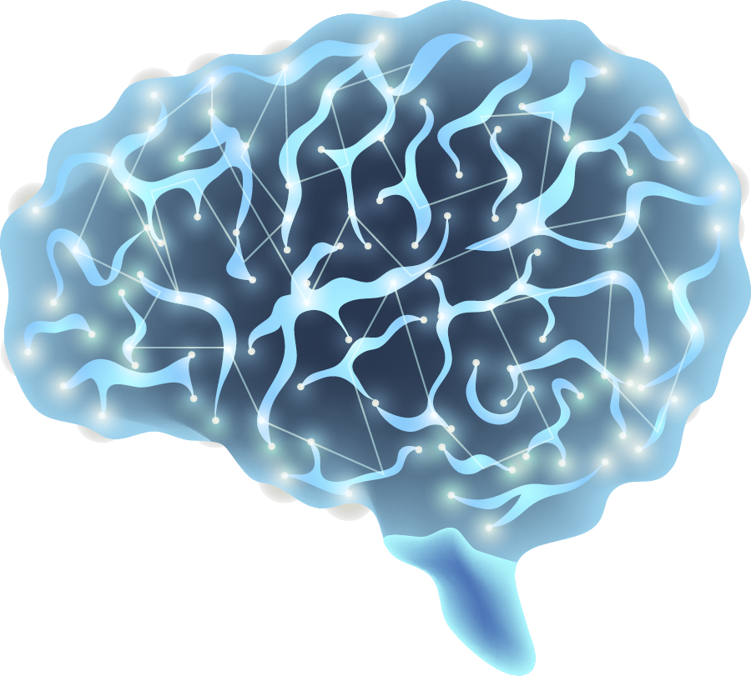
The Importance of Early Detection Of Tumor
01
The initial detection of malignant region always helps in early diagnosis of an affected person which is one of the factors for reducing death.
Detection of cancer, specifically an earlier detection, holds the potential to make a difference in treatment.
02
Earlier detection is vital because lesions in earlier stages are more likely curable.
03

Slide 8
The most common modalities that are utilized to analyze the tumor in the brain are:
Computed
Tomography (CT)
Magnetic Resonance Imaging (MRI)
Positron Emission Tomography (PET)

Slide 9
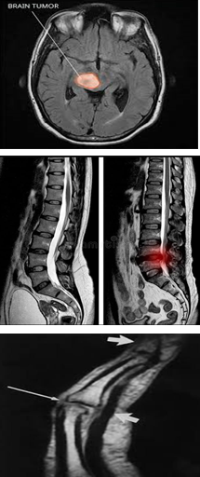
The importance of magnetic resonance imaging (MRI)
Brain Magnetic Resonance (MRI) is a very familiar medical activity that is used for analysis and diagnosis of many neurological diseases like:
Brain tumor.
spinal cord tumor.
Torn joint ligaments.
For tumor detection, radiologists have extensively exploited the medical imaging technique. Because of its astronomical nature, MRI is the most chosen technology for brain malignancies among the current modalities.

Slide 10
Contributions of this work
Improvement in CNN performance by applying ResNet50-VGG19 as pretrained model, and applying geometrical and statistical data augmentation techniques on brain tumor MRI, for an early and reliable detection of brain tumor to assist in the rapid treatment planning.
A technique consisting of pre-processing on images, feature extraction, reduction of feature space, and finally classification of images into positive and negative diagnosis of brain tumor.
Evaluation of the power of combined model by classifying totally testing data

Slide 11
Contributions of this work con.
Producing up to 99.75% accuracy on the testing data by the our combined model.
A comprehensive comparative analysis with the other existing systems.

Slide 12
The Deep Learning (DL)
Deep learning (DL) can help you improve your performance.
The DL being the subset of Machine Learning(ML) does not involve the use of any manual features .
DL has been advocated for use in medical imaging for classification, detection, and segmentation in several disciplines.

Slide 13
Convolutional neural network (CNN)
In 1980, CNN was used for the first time.
It is essentially a multilayer perceptron (MLP) network in disguise.
A CNN combines feature extraction and classification processes, requiring less preprocessing and feature extraction.
A CNN can extract important and related features from photos automatically.
A CNN can also produce high recognition accuracy even if just a little amount of training data are provided.[4]

Slide 14
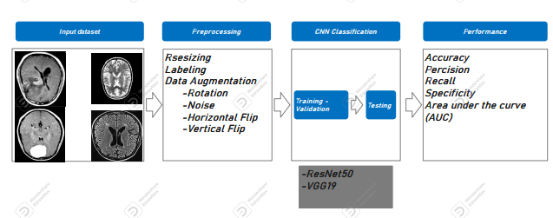
ImageNet, AlexNet, VGG19, GoogLeNet, and ResNet50 are examples of prominent CNN models that have achieved substantial advances in image recognition, in this research we used ResNet50 and VGG19 as pre-trained model for Generic CNN model
(see figure1 )
Figure 1: Flow diagram of the suggested method for BT classification.

Slide 15
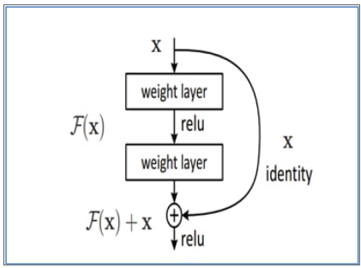
Pre-trained Resnet50
The pre-trained Resnet50 model applications, which has largely been adopted and approved by researchers working on image classification tasks and medical image analysis.
By having skip-connection-based Identity blocks, the resnet has already resolved the deep-hidden layer problems in convolutional neural networks. (see figure 2 )
Figure 2: A Residual Block Architecture

Slide 16
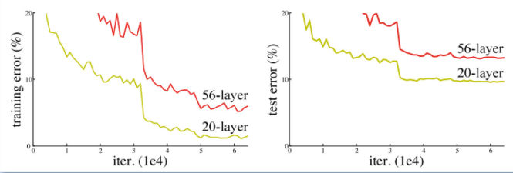
What is deep-hidden layer problems in CNN?
That means, theoretically it is known that by increasing hidden layers in the neural network ,the accuracy must increase.
But in a real case scenario, it doesn't happen.
By merely stacking layers on top of one another, network depth cannot be increased.
Since the gradient is back-propagated to earlier layers and may become arbitrarily small through repeated multiplication , deep networks are notoriously difficult to train. As a result shows that as the network develops deeper, its performance becomes saturated or even starts to decline quickly
(shown in figure 3)
Figure 3: Increasing network depth leads to worse performance

Slide 17
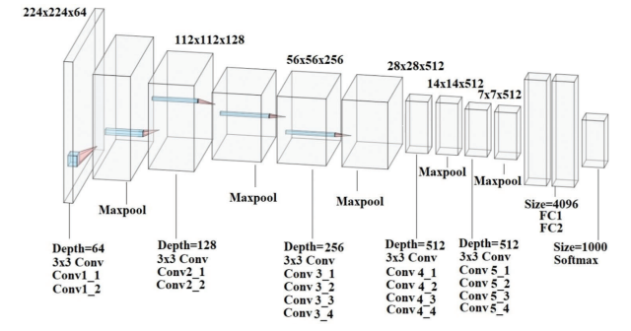
Visual Geometry Group(VGG19)
VGG-19 deep neural network was trained and tested using the derived feature sets from the KAGGLE fundus image dataset containing 35,126 images in total.
The VGG-19 is trained with features extracted from 20,000 images and tested with features extracted from 5,000 images to achieve a sensitivity of 82% and an accuracy of 96%.
The VGG-19 model comprised of 19 deep trainable layers performing convolution, which is fully connected with max pooling and dropout layers.
(VGG-19 architecture was presented in Figure 4)
Figure 4: VGG-19 architecture

Slide 18
This research focuses on the early diagnosis of brain tumors using Convolutional Neural Networks (CNNs) to improve the accuracy of state-of-the-art diagnoses. The proposed CNN is trained on abenchmark dataset, BR35H, which contains brain tumor MRIs. To enhance accuracy, we combined the VGG-19 pre-trained model with the Residual Neural Network (ResNet-50), resulting in a high-quality performance. This combined model achieved an impressive accuracy rate of 99.75%. The development of these techniques could greatly assist clinicians specializing in the early detection of brain tumors

Slide 19
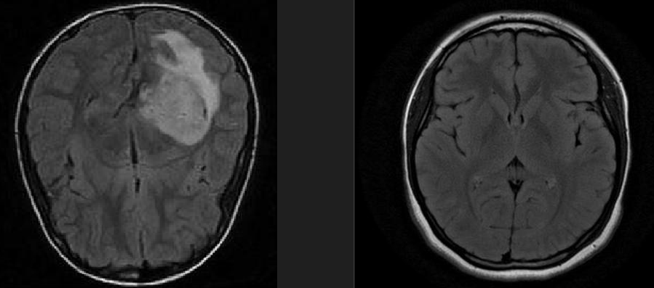
Our Dataset
For testing the accuracy and performance of the proposed model, the dataset used is Brain Tumor Classification (MRI) from the Kaggle.
The Br35H dataset provided by kaggle contains little contrast-enhanced images containing almost
3000MRI with 1500 “yes” and 1500 “no”.
The sample image with brain tumor (Yes) and without brain tumor (No) from the dataset (are shown in Figure 5) .
The dataset is preprocessed using a variety of approaches, including resizing, labeling, and data augmentation (Rotation, Noise, Horizontal Flip , and Vertical Flip ).
Figure 5: Sample image with brain tumor (Yes) and without brain tumor (No).

Slide 20
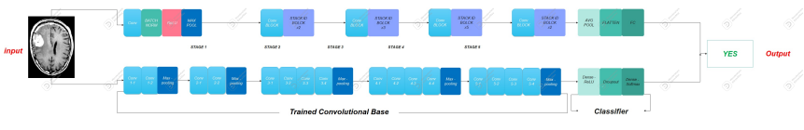
Proposed Model
In this work, the ResNet50 and VGG19 both were applied.
The combined model takes in an input image and passes it through both the VGG19 and ResNet50 models.
The outputs of these models are then concatenated and passed through a fully connected layer to produce the final output shown in Figure 6.
Figure 6: combined model architecture.

Slide 21
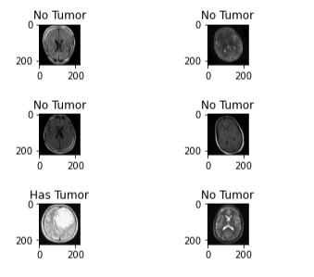
RESULTS AND DISCUSSION
our model can leverage the strengths of both models for better performance on the classification task and improve the accuracy on the testing dataset to 99.75% better than the accuracy of each of them individually. (Shown in the table 1)
Simulation is performed by using python language.
The proposed model successfully classifies and predicts the medical image (see figure 7).
ResNet50 | Vgg19 | ReNet50&vgg19
98.8% | 96% | 99.75%
Table 1
Figure 7: Prediction result.

Slide 22
RESULTS AND DISCUSSION Con.
Table 2 outlines the Accuracy results of our proposed combined model.
The training accuracy of the proposed combined model was found to be 99.94% , whereas its validation accuracy was 99.95%.
Combined model | Accuracy
Train | 99.94%
validation | 99.95%
Test | 99.75%
Table 2: Performance of the Proposed Model

Slide 23
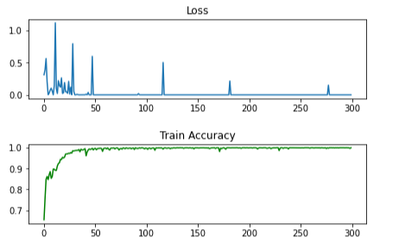
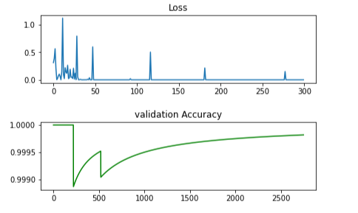
RESULTS AND DISCUSSION Con.
Figures 8,9 show the training, validation accuracy, and loss analyses of the proposed models concerning the number of epochs.
Figure 8 : Training accuracy and loss analyses.
Figure 9 : Validation accuracy and loss analyses.

Slide 24
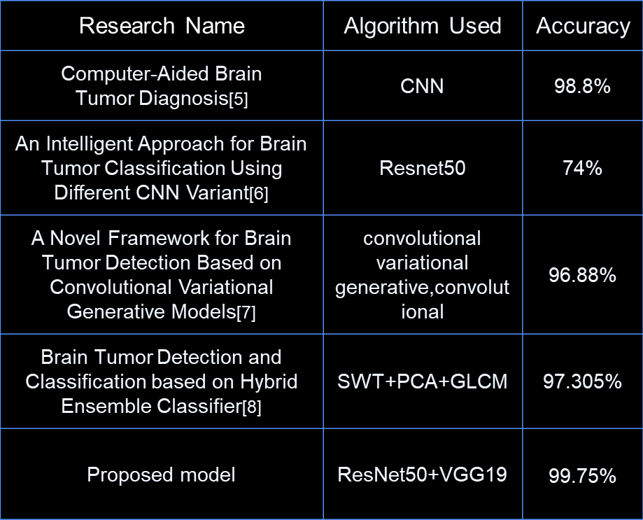
RESULTS AND DISCUSSION Con.
The accuracy is calculated and compared with the all other state of arts methods (see table 3)
Table 3: Comparative analysis of the proposed system with the other
CAD systems.

Slide 25
Conclusion
We suggested an automated method for classification brain tumor using MRI.
The suggested model, which supports automated feature learning from brain MRIs, is made up of two models (ResNet50 +VGG19).
The major purpose of developing such a network was to get a higher classification result while learning at a quicker rate than traditional DL models.
Future Work
We can classify the data into more class labels with the higher accuracy.
We can segment the image to identify the tumors’location

Slide 26
Our Application

Slide 27
We have applied our model as an application so that it is easy to use for the radiologist, as he only uploads the image and the application shows the result, whether the image contains a tumor or not.

Slide 28
Frontend :
For the structure and style of our website, we utilize a combination of HTML, CSS, and JavaScript.
Backend:
We use Flask (Version 1.1.2) framework for linking the backend (server-side) with the frontend (client-side) of a website.
In our development process, we utilize Visual Studio Code (VS Code) as our text editor of choice.
In the server-side development of our website, we employ Python (Version 3.9.12) as our programming language of choice.

Slide 29
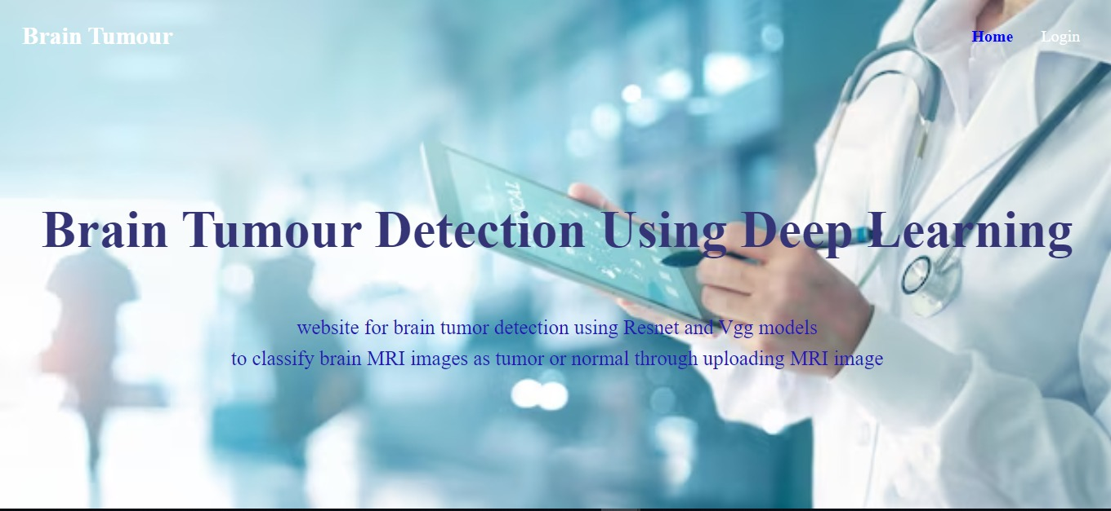
Home Page:

Slide 30
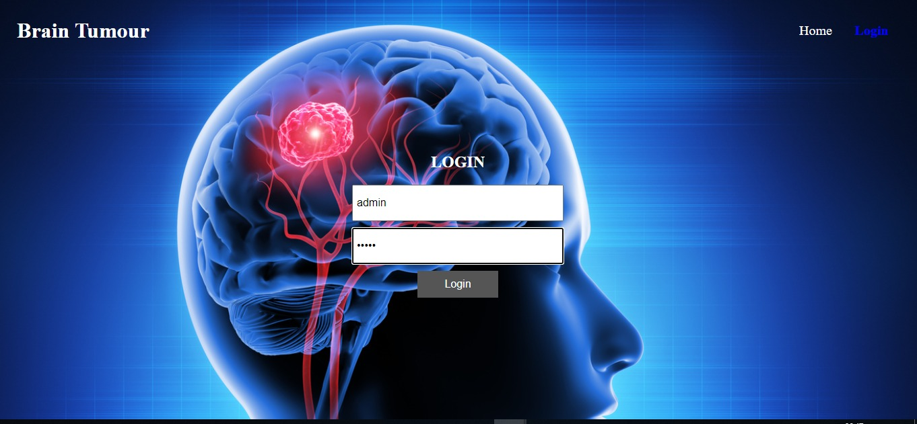
Login Page:

Slide 31
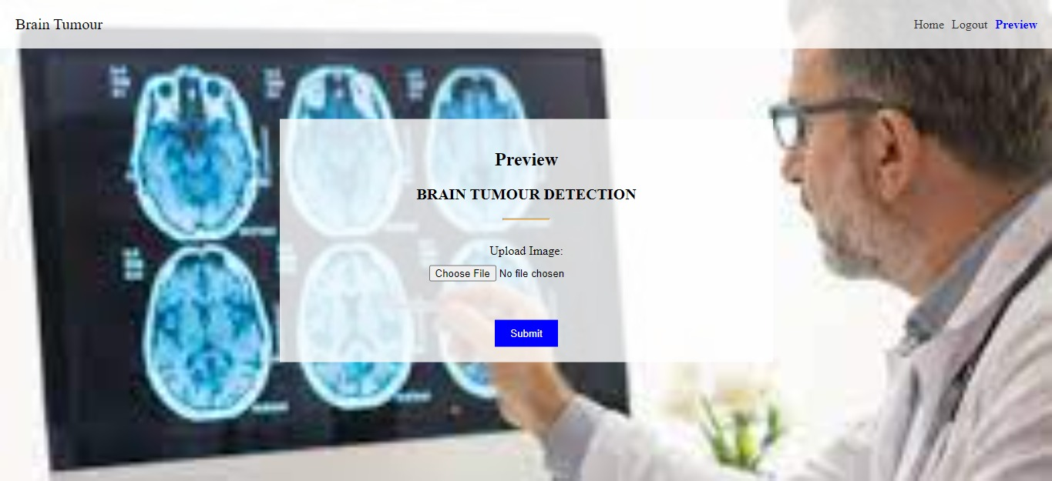
Upload Image:

Slide 32
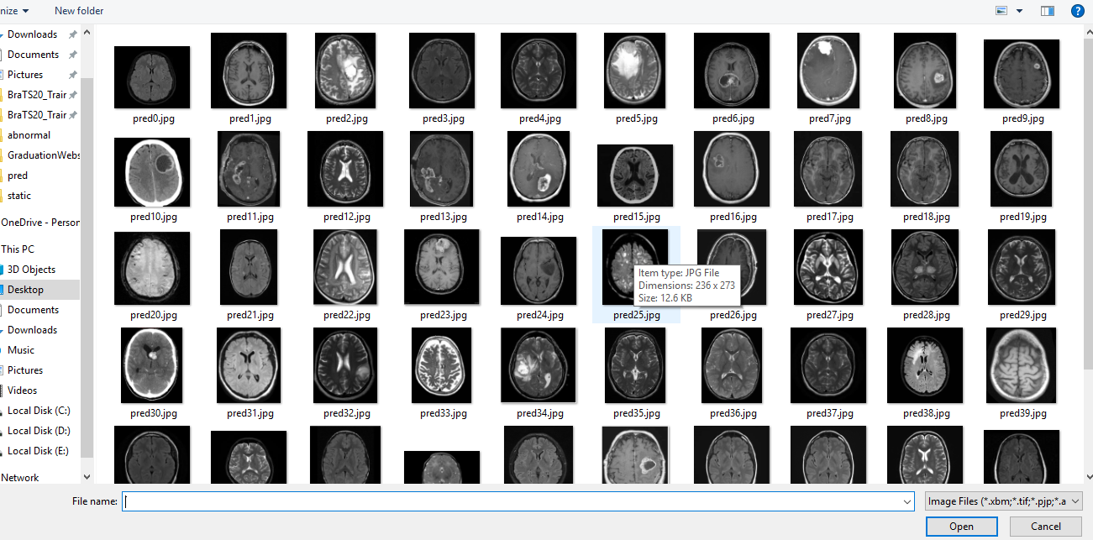
Choose Image:

Slide 33
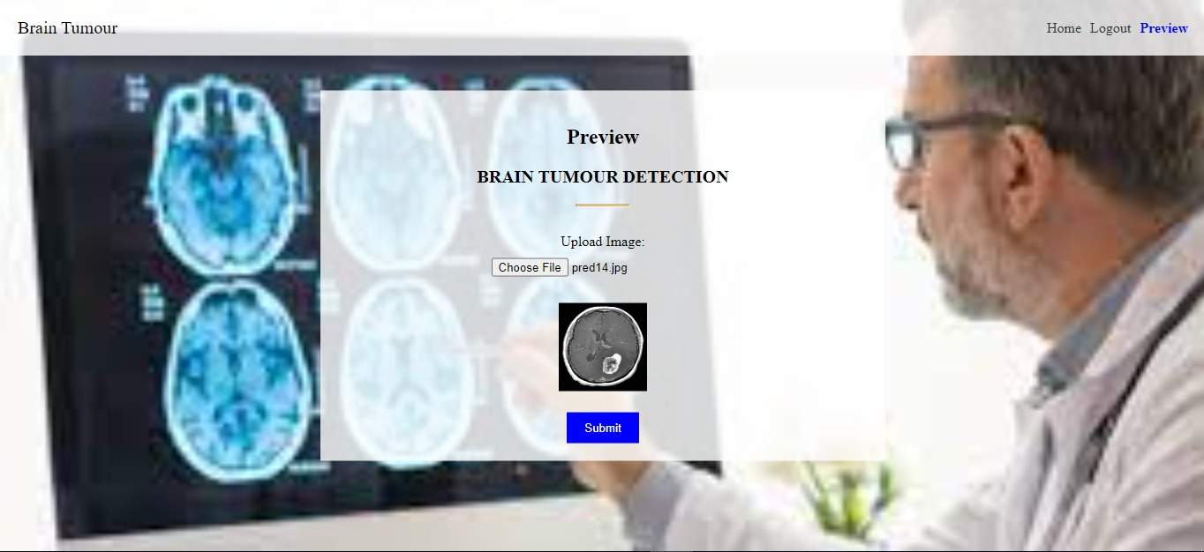
After choosing image :

Slide 34
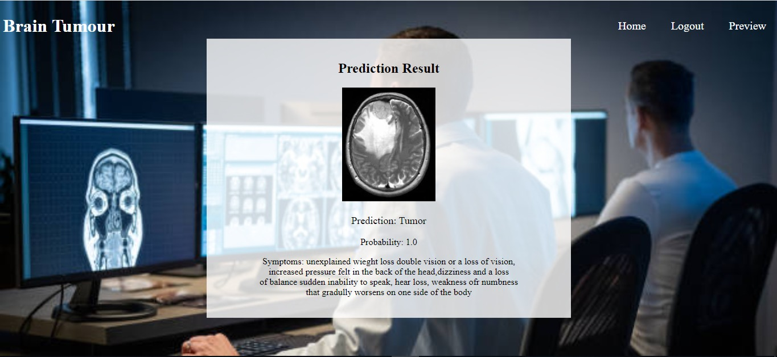
Prediction page :

Slide 35
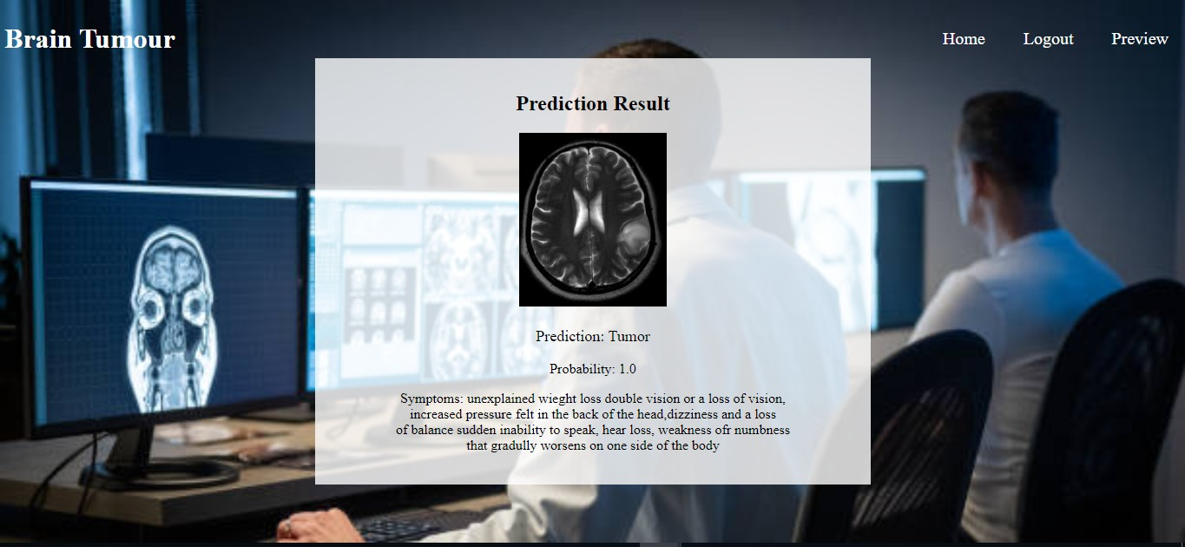
Prediction page :

Slide 36
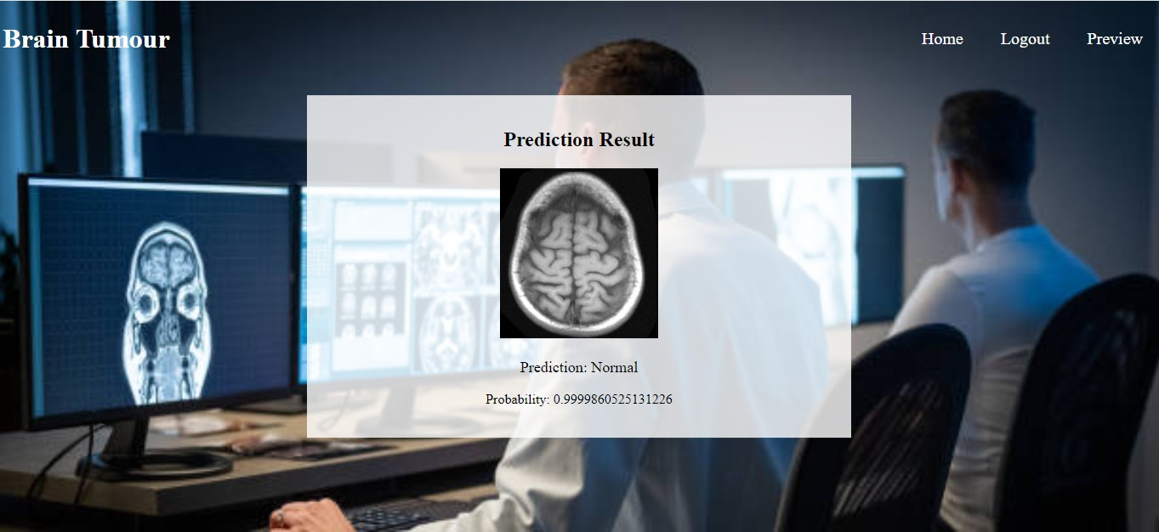
Prediction page :

Slide 37
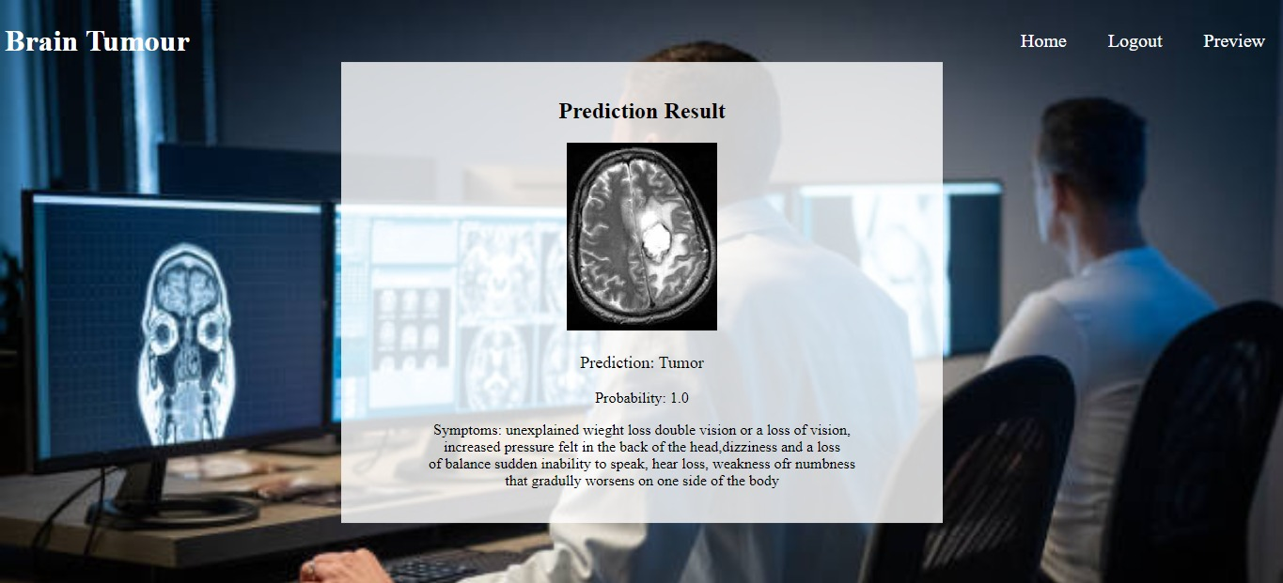
Prediction page :

Slide 38
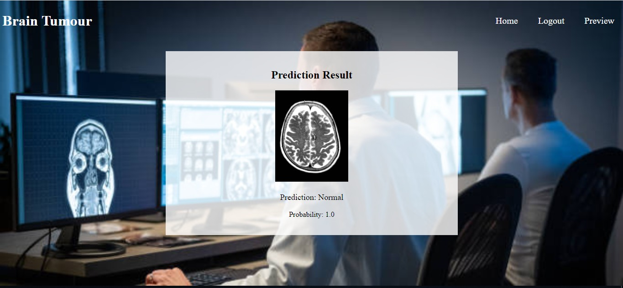
Prediction page :

Slide 39
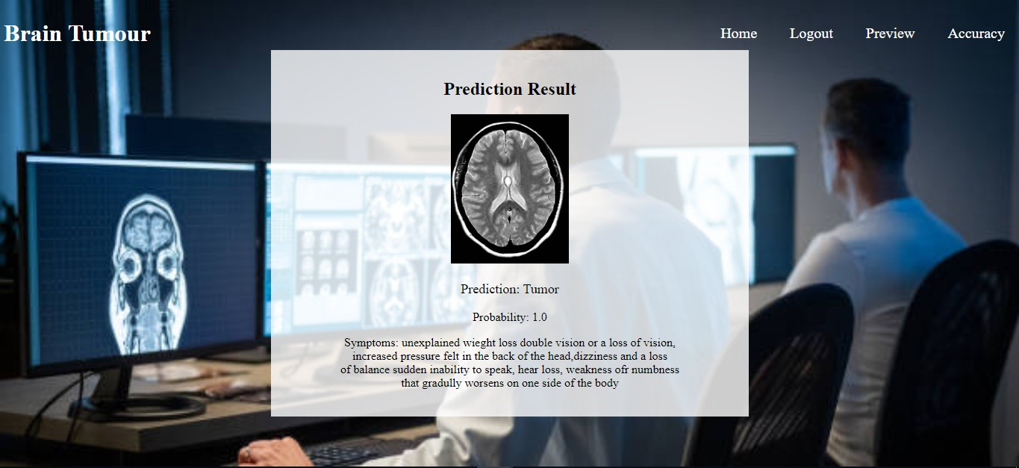
Prediction page :

Slide 40
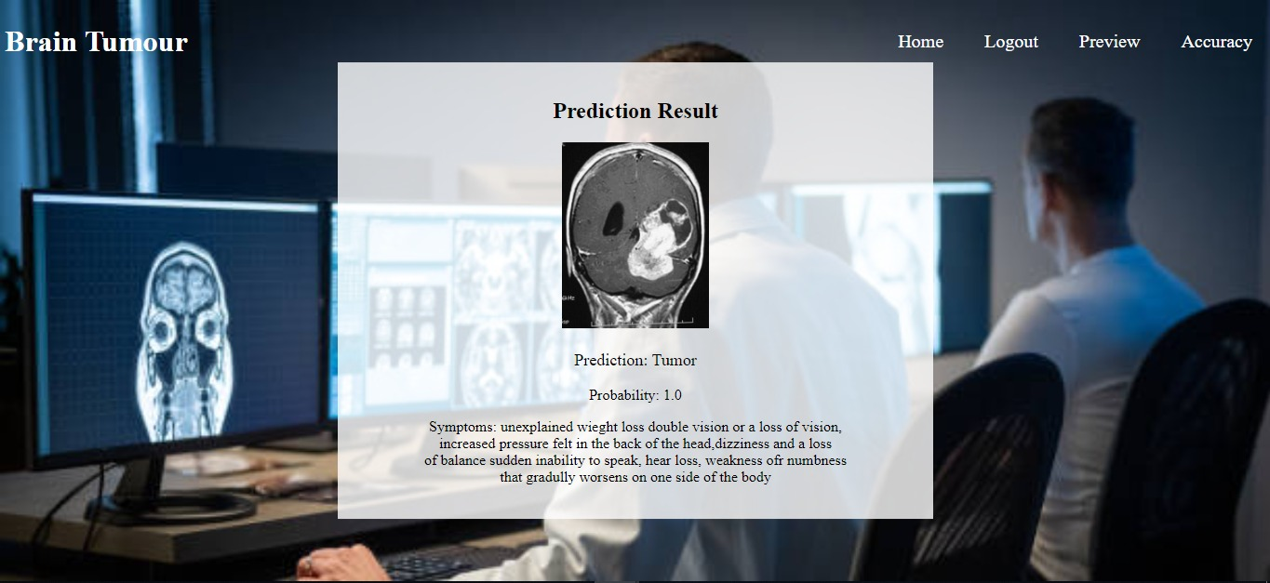
Prediction page :

Slide 41
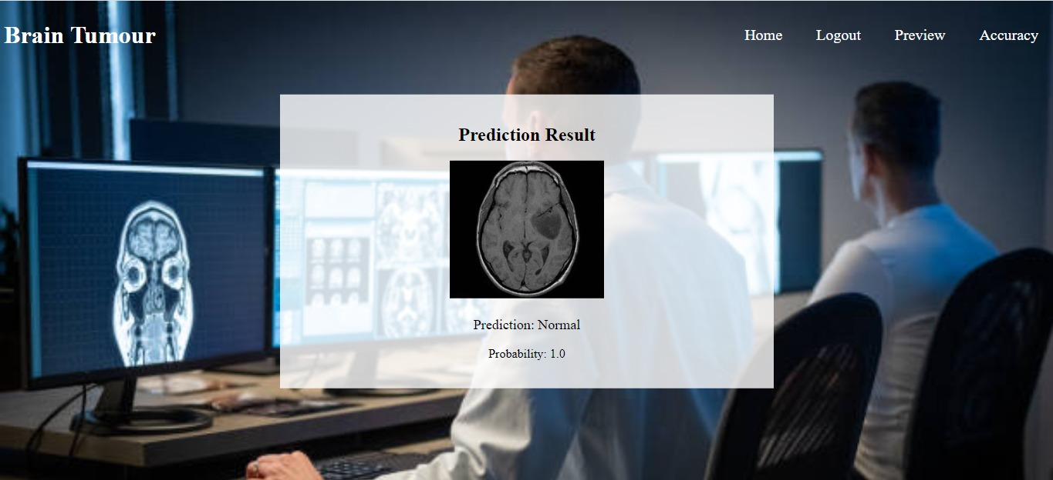
Prediction page :

Slide 42
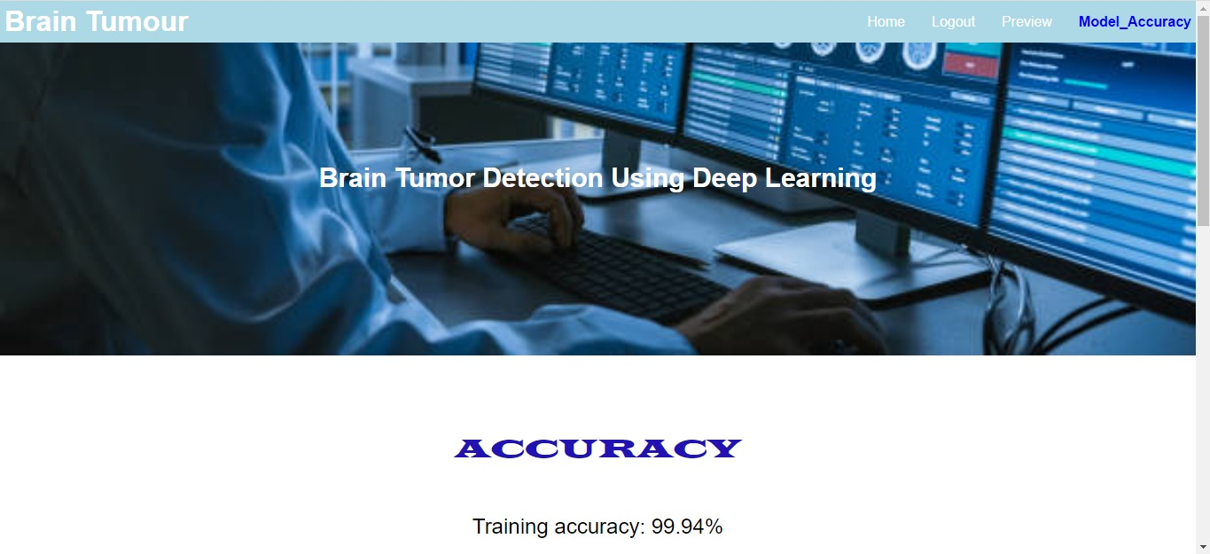
Model-Accuracy page :

Slide 43
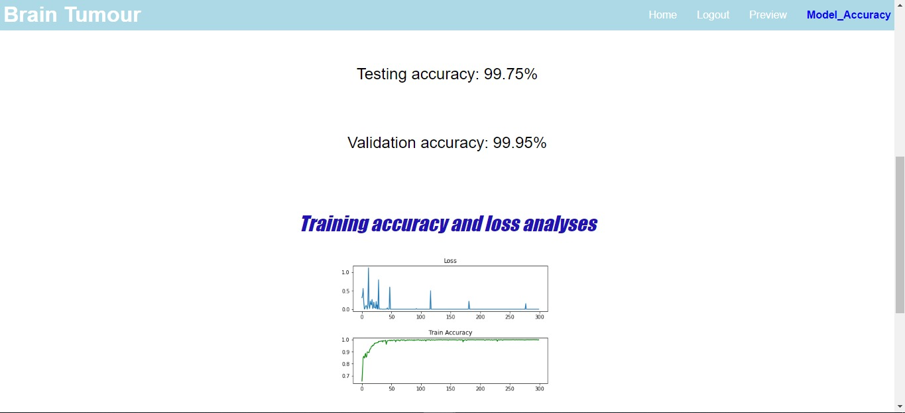
Model-Accuracy page :

Slide 44
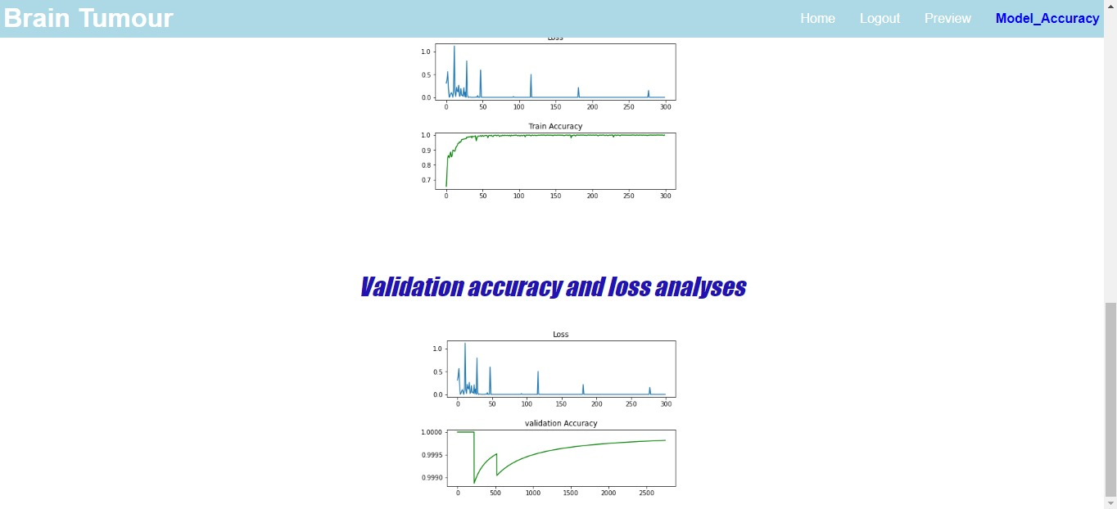
Model-Accuracy page :

Slide 45
Referances
[1] https://arxiv.org/pdf/2208.00768
[2] https://www.cancer.org/cancer/types/brain-spinal-cord-tumors-adults/about/key statistics.html#:~:text=The%20American%20Cancer%20Society%E2%80%99s%20est mates%20for%20brain%20and,higher%20if%20benign%20%28non cancer%29%20tumors%20were%20also%20included
[3] https://link.springer.com/article/10.1007/s11042-022-12977-y
[4] https://www.mdpi.com/2079-9292/12/4/955
[5] https://doi.org/10.1155/2021/5513500
[6] https://link.springer.com/chapter/10.1007/978-981-99-3478-2_1
[7] https://link.springer.com/article/10.1007/s11042-022-12362-9
[8] https://arxiv.org/abs/2101.00216

Slide 46
Thanks

